Slide 1
Inception Versions
Vignesh

Slide 2
Introduction
Inception evolved in to multiple versions overtime.
The different versions of Inception are as follows:
Inception Version 1 proposes the basic Inception network
Inception Version 2 proposes batch normalization
Inception Version 3 redesigns the network by factorizing the convolutional kernel
Inception Version 4 simplifies V3 with more uniform architecture and compares the performance with Inception-ResNet

Slide 3
InceptionV1
- The main focus of Inception V1 is find an efficient deep neural network architecture for computer vision. The most straightforward way to improving the performance of DNN is simply increase the depth and width. The main drawbacks of this method is the requirement of more data to overcome possible overfitting and more computational resource. The fundamental way to solve these 2 problem for computer vision system is to use sparsely connected architecture to replace the fully connected one.
- The authors made use of differnet size convolutional kernels parallely for extracting different level features
- The author use dimension reduction by applying 1×1 convotional kernels with less filters to reduce computational complexity thereby retaining the important information.

Slide 4
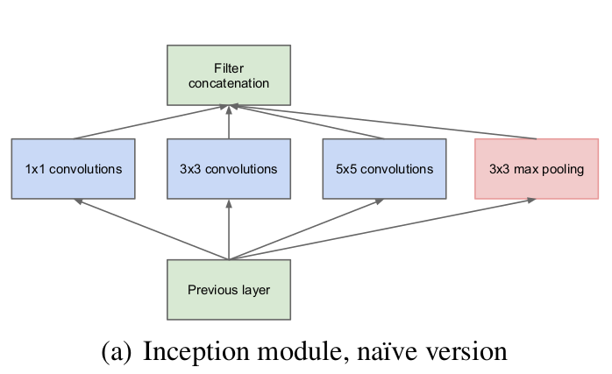
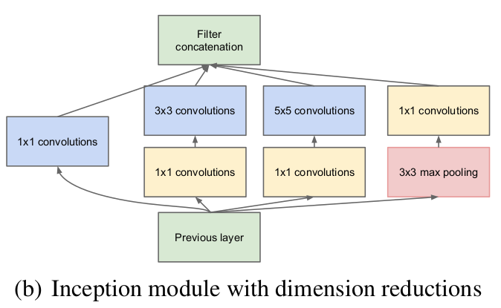
InceptionV1 blocks

Slide 5
InceptionV2
The most important contribution in InceptionV2 is introducing Batch normalization. As stated by the authors, Batch Normalization allows us to use much higher learning rates and be less careful about initialization. It also acts as a regularizer, in some cases eliminating the need for Dropout.
In Inception V2, the authors first propose the problem named Internal Covariate Shift (ICS). Then they suggest several solutions and analyse their advantage and drawbacks.
InceptionV2 and InceptionV3 were presented in same paper

Slide 6
Internal Covariate Shift(ICS)
- The change in the distribution of network activations due to the change in network parameters during training is defined as ICS.
- Normalization is often performed to the input of the image. For example, the values of pixels of an image are normalized by subtracting the mean and being divided by the standard deviation.
How can we do the same processing for all the internal input from layer to layer in a network???
Possible solution 1: Suppose the normalization is independent to the optimization. But the experiments of this hypothesis shows that the model blows up, because the normalization is outside the gradient descent step.
Possible solution 2: Take into account the normalization when doing gradient descent. However, the calculation cost is too high because of the computation of covariance matrix of all examples.

Slide 7
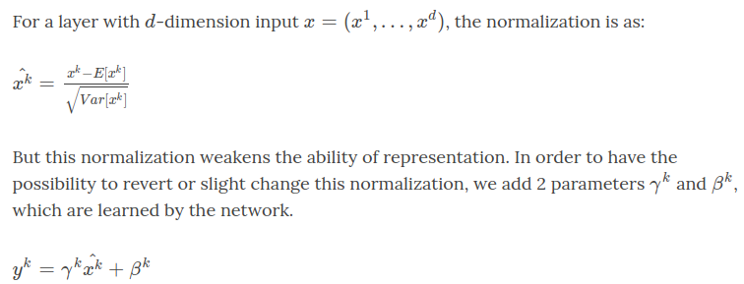
Normalization via Mini-Batch statistic
In order to reduce the computation, 2 simplifications are used:
Normalize the layer inputs and outputs separately
Use mini-batch statistics

Slide 8
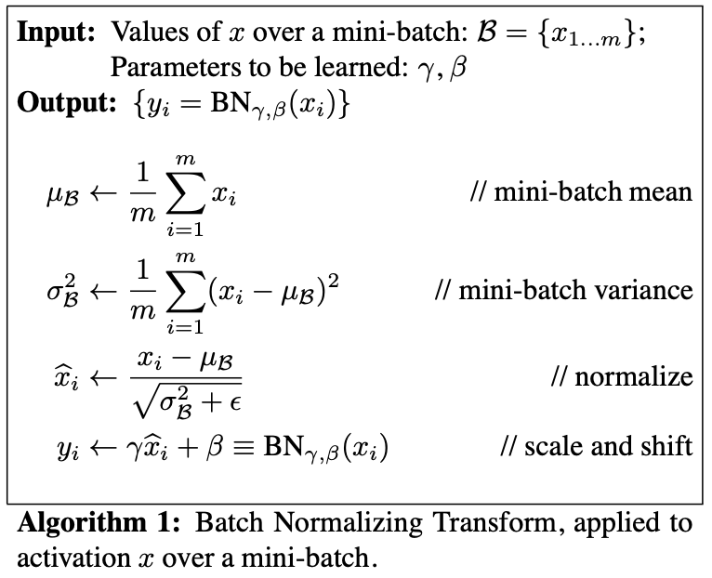
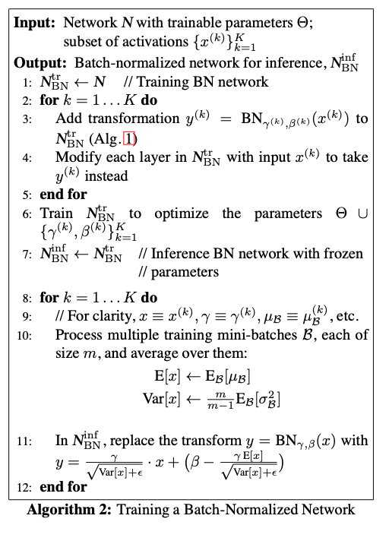
Batch Normalization Algorithm
.

Slide 9
Advantages of Batch Normalization
Speed up the training process
Stabilize the training
Add regularization, so we can reduce other regularization(Dropout, less weight decay)
BN needs more thoroughly shuffle

Slide 10
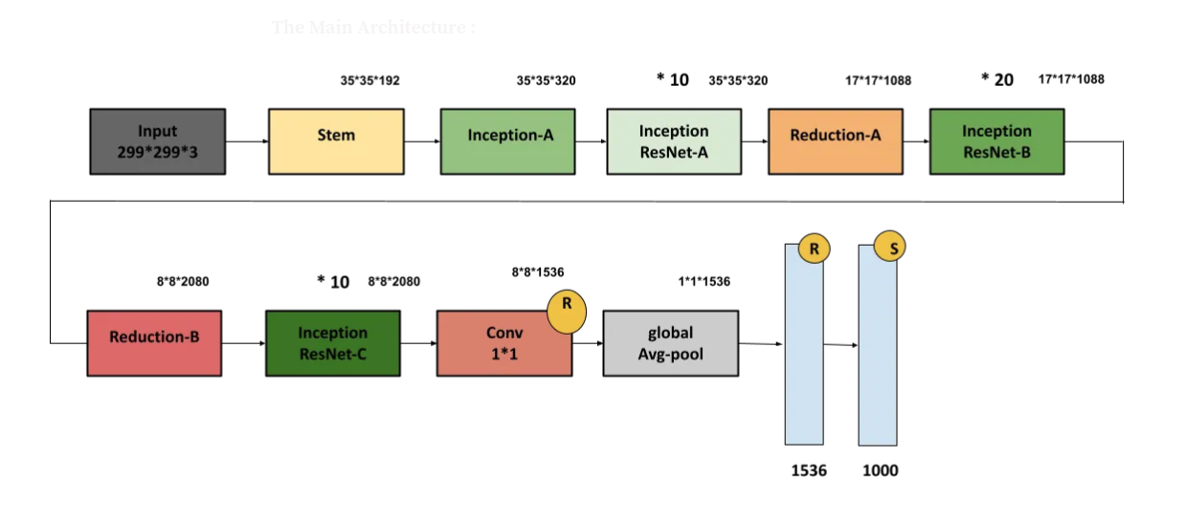
InceptionV2 architecture

Slide 11
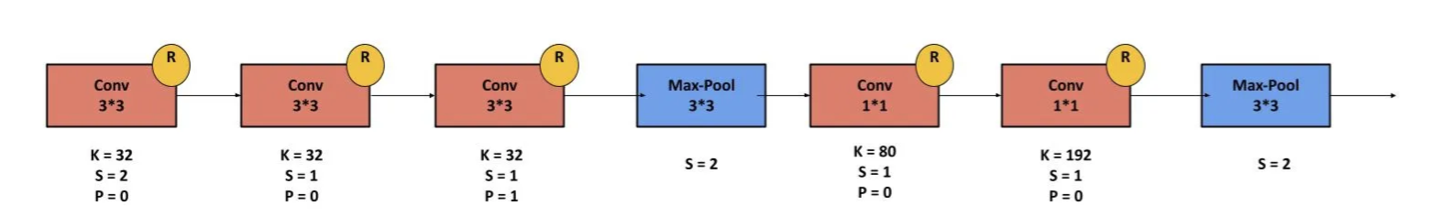
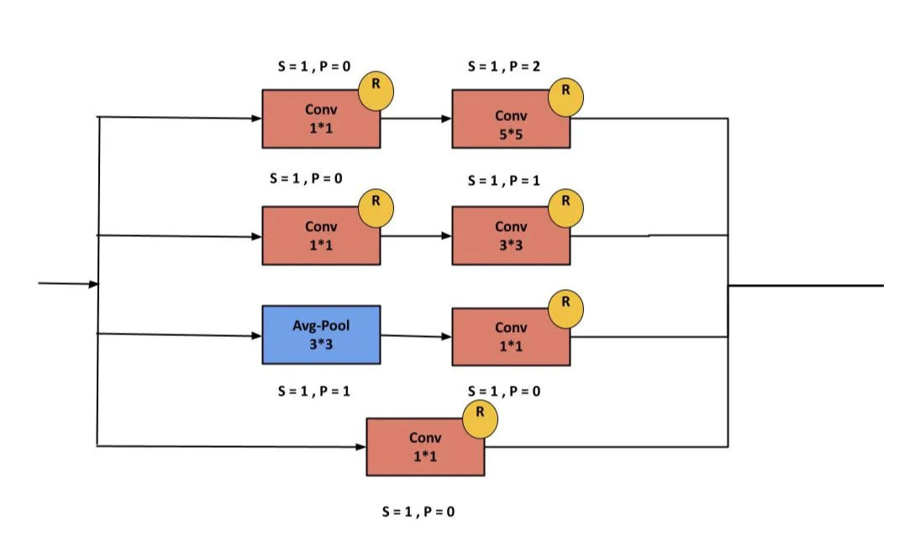
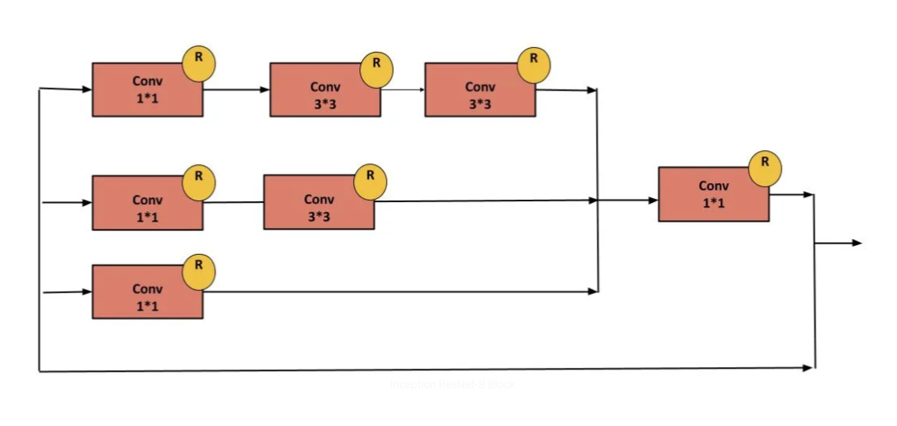
Inception V2 blocks
Stem Block
Inception A block Inception Resnet A block

Slide 12
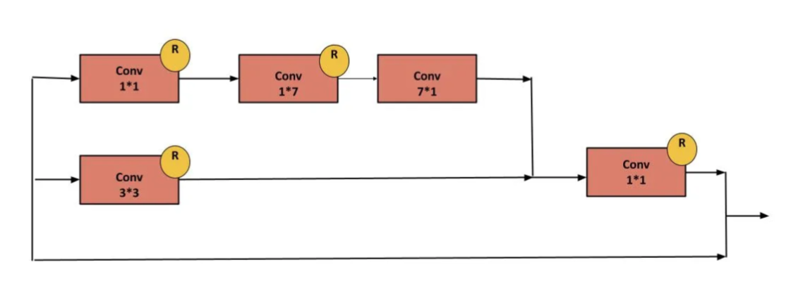
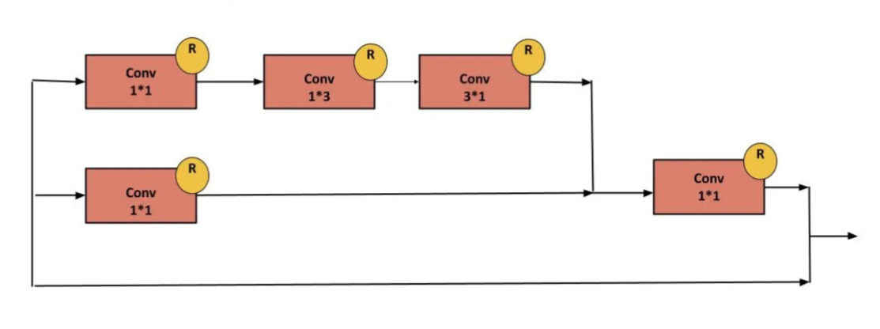
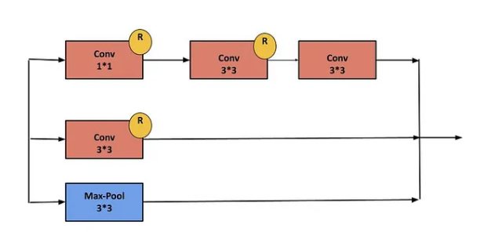
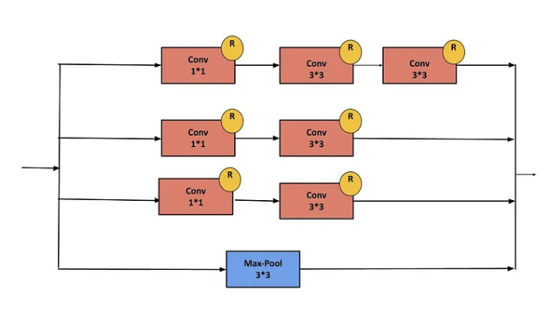
Inception V2 blocks
Inception Resnet B block
Reduction A
Inception Resnet C block
Reduction B

Slide 13
Inception V3
- Total – 48 layers deep
- With version 1 and version 2, Inception have introduced sparse representation to reduce the calculation and batch normalization to speed up and stabilize the training.
- In version 3, the authors want to explore ways to scale up networks in ways that aim at utilizing the added computation as efficiently as possible by suitably factorized convolutions and aggressive regularization.
- They give some general design principles according to their large scale experimentation with various architectural.
Avoid representational bottlenecks, especially early in the network.
Higher dimensional representations are easier to process locally within a network.
Spatial aggregation can be done over lower dimensional embeddings without much or any loss in representational power.
Balance the width and depth of the network.

Slide 14
Factorizing convolutions
- The major modifications done on the Inception V3 model are
Factorization into Smaller Convolutions : larger convolutional kernel can be replaced by several times of smaller kernels. In Inception V3, 5×5 convolutional kernel is replace by 2 3×3 convolutional kernel
Spatial Factorization into Asymmetric Convolutions : replace any n × n convolution by a 1 × n convolution followed by a n × 1 convolution and the computational cost saving increases dramatically as n grows
Utility of Auxiliary Classifiers : for faster model convergence only during training.
Efficient Grid Size Reduction
- The ideas of factorizing convolutions come from the discuss between added computation and benefits. For instance,
the computation of a 5×5 convolutional kernel is 26/9 = 2.78 times of the one of 3×3 convolutional kernel.
However, the similar results of applying 5×5 convolutional kernel can be achieved by applying 2 times 3×
3 convolutional kernel. Meanwhile, the computation is less (9 + 9 < 25).

Slide 15
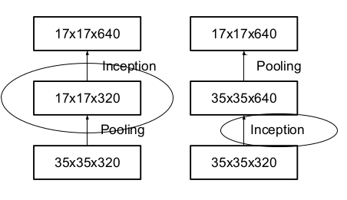
InceptionV3 techniques
Efficient grid size reduction
Traditionally, convolutional networks use some pooling before convolution operations to reduce the gride size of the feature maps. Problem is, it can introduce a representational bottleneck.The authors think that increasing the number of filters (expand the filter bank) remove the representational bottleneck. This is achieved by the inception module.
The right side is more expensive so they proposed another solution that reduces the computational cost while eliminating the bottleneck (by using 2 parallel stride 2 pooling/convolution blocks).
Label Smoothing
A type of regularizing component added to the loss formula that prevents the network from becoming too confident about a class. Prevents over fitting.
Deal with low resolution image
One simple way to ensure constant effort is to reduce the strides of the first two layer in the case of lower resolution input, or by simply removing the first pooling layer of the network.

Slide 16
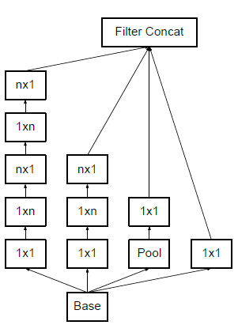
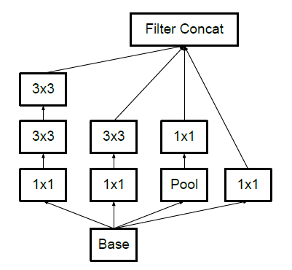
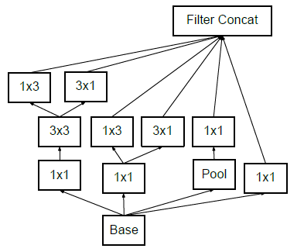
InceptionV3 blocks
Factorization in to smaller convolutions Asymmetric Convolutions Final inception module
5×5 convolutional layer was replaced by replace the 3×3 convolutions with a 1×3 Applying previous 2 techniques
two 3×3 convolutional layers convolution followed by a 3×1 convolution

Slide 17
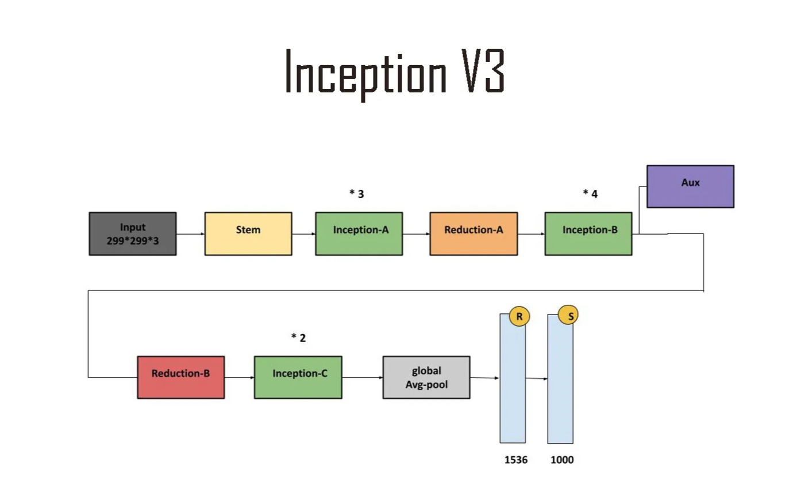
InceptionV3 Architecture

Slide 18
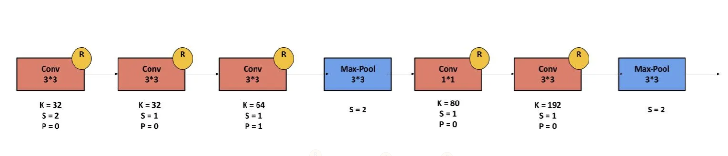
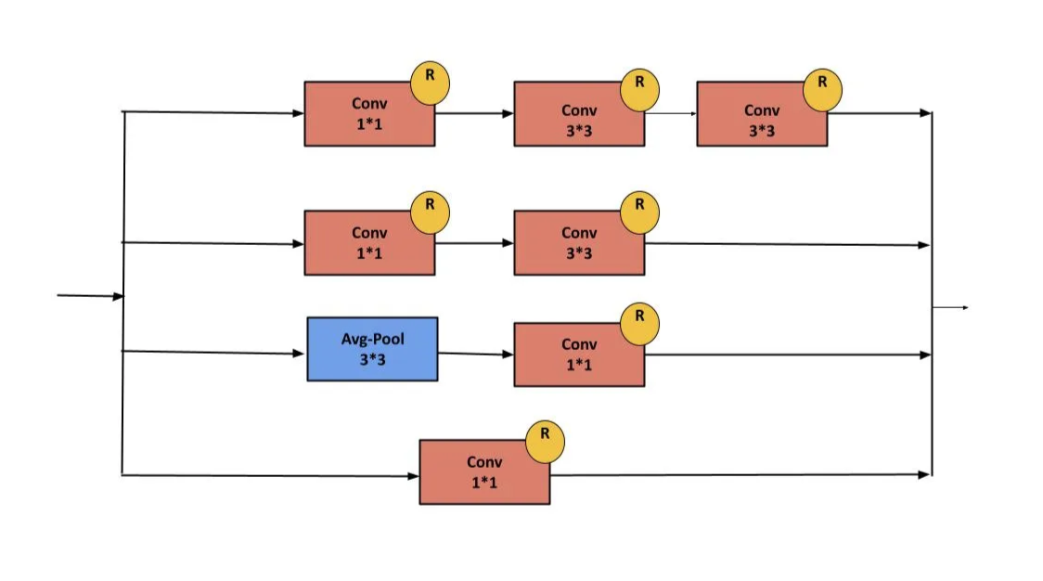
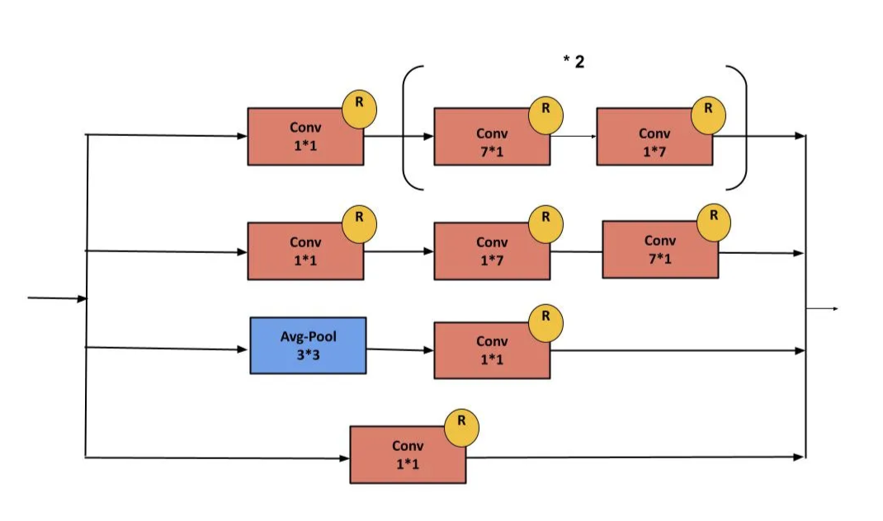
InceptionV3 architecture
Stem block
Inception A
Inception B

Slide 19
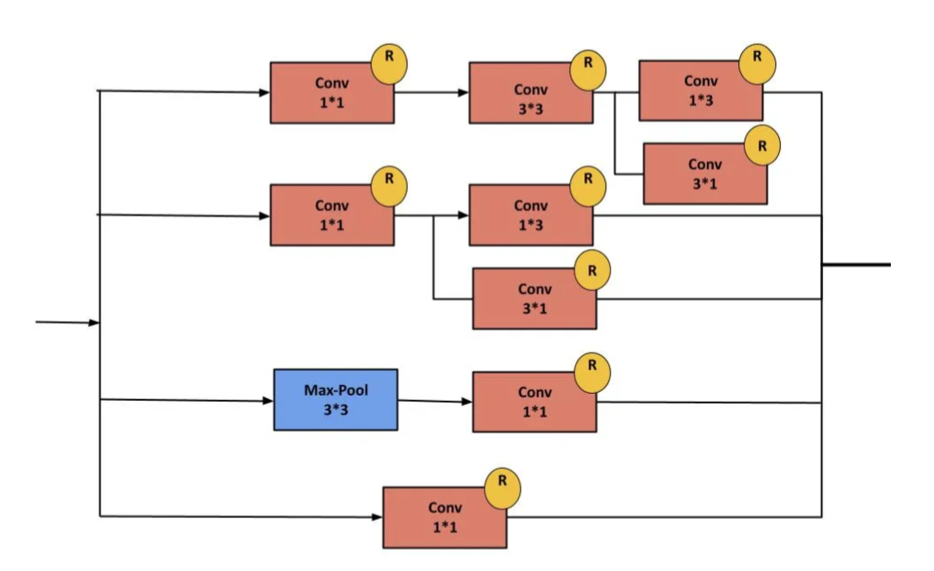
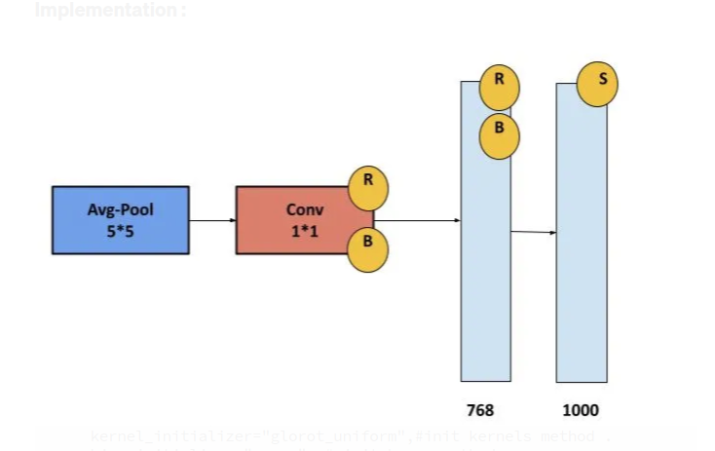
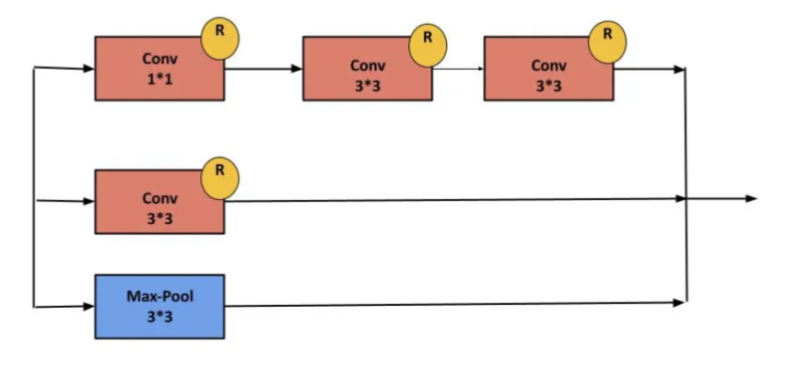
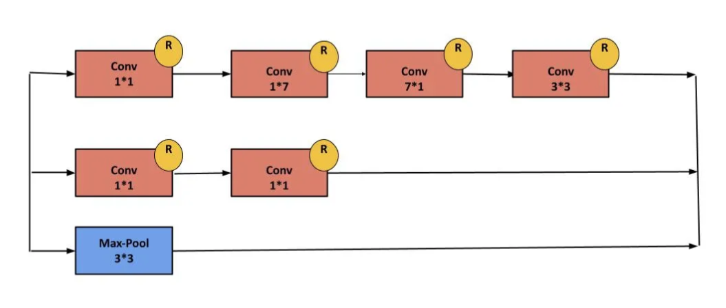
InceptionV3 architecture
Aux
Reduction A
Inception C
Reduction B

Slide 20
InceptionV4
Inception V4 was introduced in combination with Inception-ResNet by the researchers a Google in 2016. The main aim of the paper was to reduce the complexity of Inception V3 model which give the state-of-the-art accuracy on ILSVRC 2015 challenge. This paper also explores the possibility of using residual networks on Inception model
Architectural Changes in Inception-V4:
In the paper there are two types of Inception architectures were discussed.
Pure Inception architecture (Inception -V4):
The initial set of layers which the paper refers “stem of the architecture” was modified to make it more uniform . These layers are used before Inception block in the architecture.
This model can be trained without partition of replicas unlike the previous versions of inceptions which required different replica in order to fit in memory. This architecture use memory optimization on back propagation to reduce the memory requirement.
Inception architecture with residuals:
The authors of the paper was inspired by the success of Residual Network. Therefore they explored the possibility of combining the Inception with ResNets. They proposed two Residual Network based Inception models: Inception ResNet V1 and Inception ResNet V2. Let’s look at the key highlights of these architectures.

Slide 21
InceptionResnets
The Inception block used in these architecture are computationally less expensive than original Inception blocks that we used in Inception V4.
Each Inception block is followed by a 1×1 convolution without activation called filter expansion. This is done to scale up the dimensionality of filter bank to match the depth of input to next layer.
The pooling operation inside the Inception blocks were replaced by residual connections. However, pooling operations can be found in reduction blocks.
In Inception ResNets models, the batch normalization not used after summations. This is done to reduce the model size to make it trainable on a single GPU.
Both the Inception architectures have same architectures for Reduction Blocks, but have different stem of the architectures. They also have difference in their hyper parameters for training.
It is found that Inception-ResNet V1 have similar computational cost as of Inception V3 and Inception-ResNet V2 have similar computational cost as of Inception V4.

Slide 22
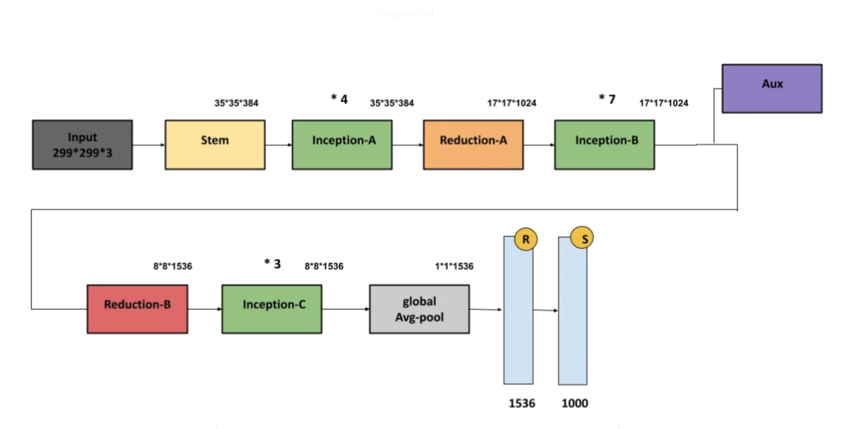
InceptionV4 architecture

Slide 23
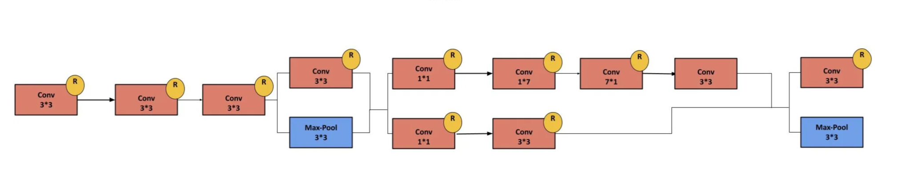
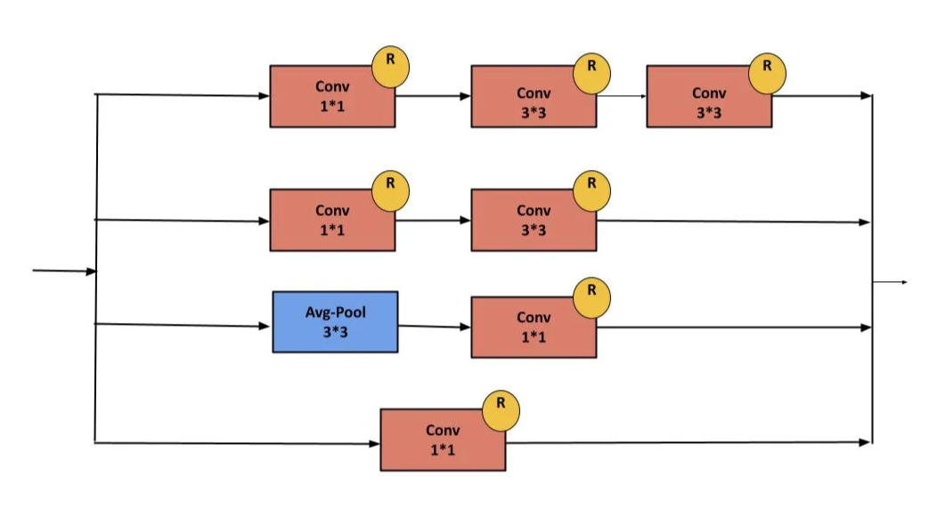
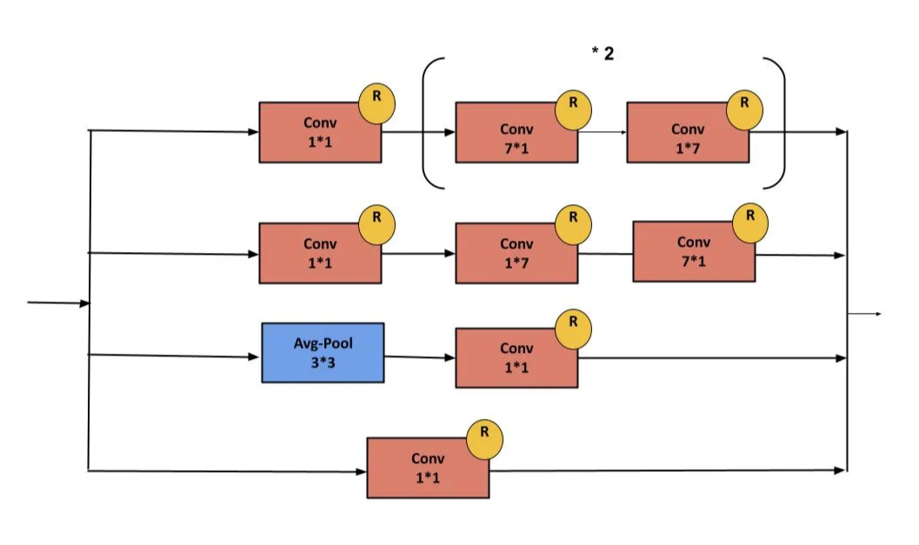
InceptionV4 architecture
Stem
Inception A
Inception B

Slide 24
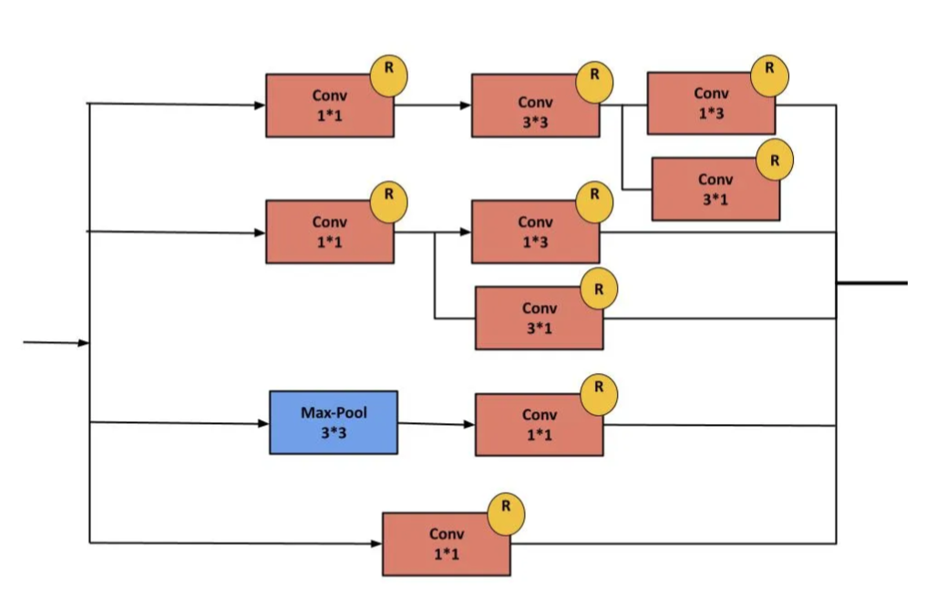
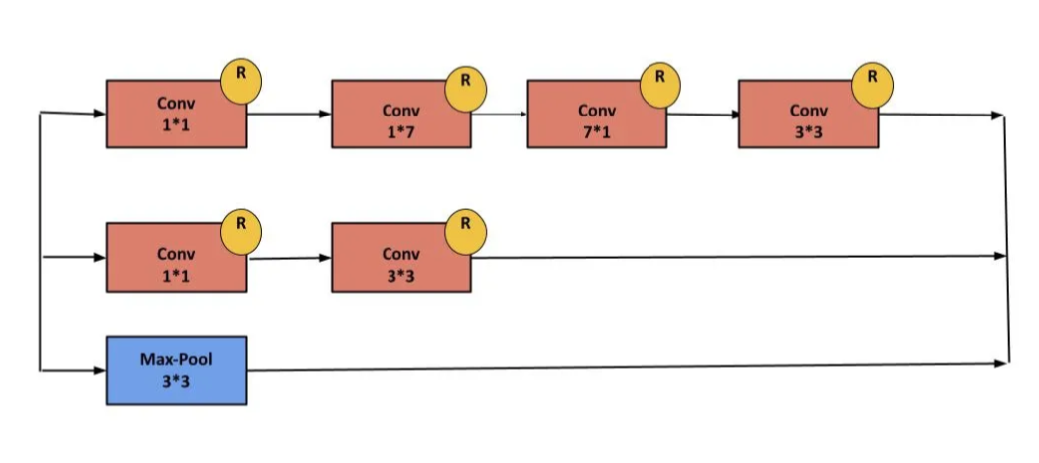
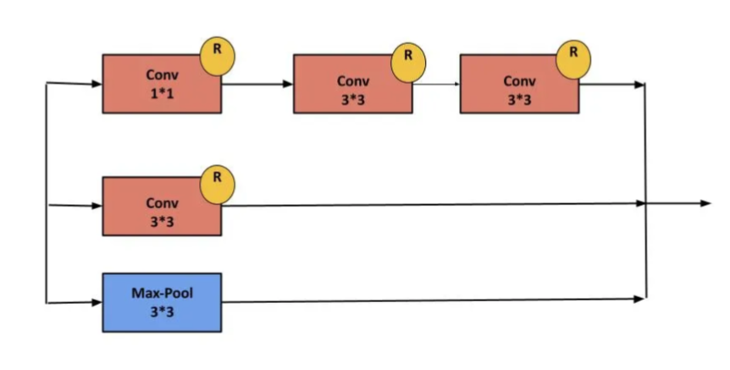
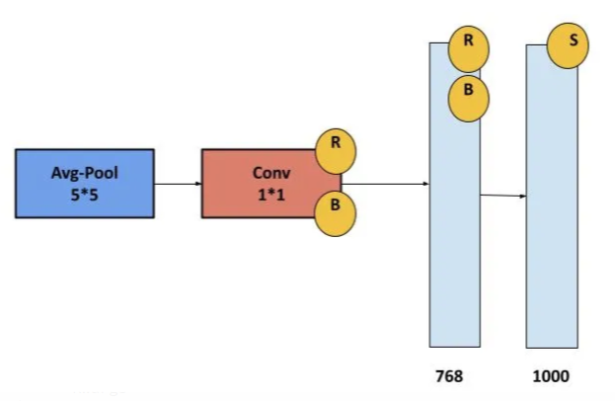
InceptionV4 architecture
InceptionC
ReductionA
Reduction B
Aux

Slide 25
References
Christian Szegedy, Wei Liu, Yangqing Jia, Pierre Sermanet, Scott Reed, Dragomir Anguelov, Dumitru Erhan, Vincent Vanhoucke, Andrew Rabinovich Going Deeper with Convolutions CVPR 2014
Ioffe, Sergey and Szegedy, Christian Batch normalization: Accelerating deep network training by reducing internal covariate shift 2015
Szegedy, Christian and Vanhoucke, Vincent and Ioffe, Sergey and Shlens, Jon and Wojna, Zbigniew Rethinking the inception architecture for computer vision CVPR 2015
Szegedy, Christian and Ioffe, Sergey and Vanhoucke, Vincent and Alemi, Alexander A Inception-v4, inception-resnet and the impact of residual connections on learning AAAI 2016
He, Kaiming and Zhang, Xiangyu and Ren, Shaoqing and Sun, Jian Deep residual learning for image recognition CVPR 2015
He, Kaiming and Zhang, Xiangyu and Ren, Shaoqing and Sun, Jian Very deep convolutional networks for large-scale image recognition 2015

Slide 26
References
Review of Inception from V1 to V4
A Simple Guide to the Versions of the Inception Network
Inception V2 and V3 – Inception Network Versions
Inception-V2/V3: Summary and Implementation
Inception-V4 and Inception-ResNets
Inception V3 CNN Architecture Explained

